Slide 1

Chapter 11
Multimedia Processing

Slide 2
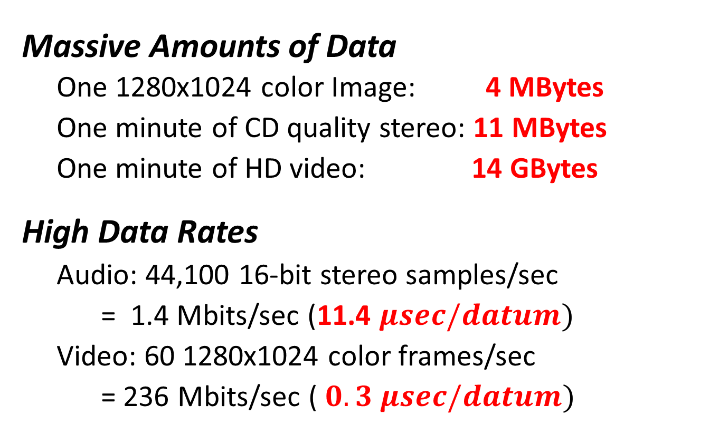
Multimedia Data
Massive Amounts of Data
One 1280x1024 color Image: 4 MBytes
One minute of CD quality stereo: 11 MBytes
One minute of HD video: 14 GBytes
High Data Rates
Audio: 44,100 16-bit stereo samples/sec
= 1.4 Mbits/sec (11.4 $μsec/datum)$
Video: 60 1280x1024 color frames/sec
= 236 Mbits/sec ($0.3 μsec/datum)$

Slide 3
Multimedia Data
Audio, Images, Graphics, Animation, Video
Scalar Arithmetic used to increase volume, intensity, contrast, etc.
Vector Arithmetic (e.g., dot product) used in computer graphics
Matrix arithmetic used to compute perspective projections
Audio, Images, Video: Must prevent (rather than detect) overflow
Efficient Processing
Simple arithmetic operations repeated millions of times
Basic operations must be made efficient
Instructions must operate on multiple data simultaneously

Slide 4
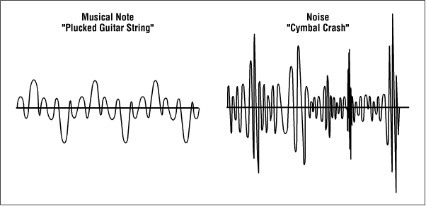
Multimedia Data Representation
255 (white)
255
255
255
+32767
8-bit mono-chrome images
24-bit
(3x8-bit) color images
0
16-bit audio channel
0 (black)
0
0
0
-32768
0 (black)

Slide 5
Parallel Processing: SIMD (Single Instruction, Multiple Data)
Each SIMD instruction performs arithmetic on multiple integers simultaneously:
Four 8-bit integers
or
Two 16-bit integers
31 | 24 | 23 | 16 | 15 | 8 | 7 | 0
SIMD processing offers 2x to 4x improvement in processing speed.
31 | 16 | 15 | 0

Slide 6


Simple SIMD: B&W Negative (1 pixel = 1 byte)
31 | 24 | 23 | 16 | 15 | 8 | 7 | 0
00001111 |  | 01010101 |  | 11001100 |  | 00000000
31 | 24 | 23 | 16 | 15 | 8 | 7 | 0
11110000 |  | 10101010 |  | 00110011 |  | 11111111
// void SIMD_Invert(uint8_t src[], uint8_t dst[], uint32_t count) ;
.global SIMD_Invert
SIMD_Invert:
loop: CBZ R2,done // test for completion (count = 0)
LDR R3,[R0],4 // Get next four bytes, bump adrs
MVN R3,R3 // Invert all four values
STR R3,[R1],4 // Store all four values, bump adrs
SUB R2,R2,4 // decrement the count by 4
B loop // repeat until done
done: BX LR // return

Slide 7
SIMD Subtraction
Operation | Ops | Format |  | GE[3] | GE[2] | GE[1] | GE[0]
Signed Subtraction | 4x8 | SSUB8 | Rd,Rn,Rm | Rn_{31..24} ≥ Rm_{31..24} | Rn_{23..16} ≥ Rm_{23..16} | Rn_{15..8} ≥ Rm_{15..8} | Rn_{7..0} ≥ Rm_{7..0}
Unsigned Subtraction | 4x8 | USUB8 | Rd,Rn,Rm
Signed Subtraction | 2x16 | SSUB16 | Rd,Rn,Rm | Rn_{31..16} ≥ Rm_{31..16} |  | Rn_{15..0} ≥ Rm_{15..0}
Unsigned Subtraction | 2x16 | USUB16 | Rd,Rn,Rm
None of these instructions affect the N, C, Z, V or Q flags.
SIMD Selection
Operation | Ops | Format |  | GE[3] | GE[2] | GE[1] | GE[0]
Select Bytes | 4x8 | SEL | Rd,Rn,Rm | 1: Rn_{31..24} 0: Rm_{31..24} | 1: Rn_{23..16} 0: Rm_{23..16} | 1: Rn_{15..8} 0: Rm_{15..8} | 1: Rn_{7..0} 0: Rm_{7..0}
31 | 30 | 29 | 28 | 27 |  |  |  |  |  |  | 0
N | C | Z | V | Q | . . .
31 | 30 | 29 | 28 | 27 |  | 19 | 18 | 17 | 16 |  | 0
N | C | Z | V | Q | . . . | GE [3] | GE [2] | GE [1] | GE [0] | . . .
But they do affect the GE (Greater than or Equal) flags:

Slide 8
SIMD Compare and Select
Step 1: SIMD Subtract
Step 2: SIMD Select
31 | 24 | 23 | 16 | 15 | 8 | 7 | 0
12 |  | 8 |  | 32 |  | 51
31 | 24 | 23 | 16 | 15 | 8 | 7 | 0
12 |  | 8 |  | 32 |  | 51
─
─
─
─
GE[3] = 1 | GE[2] = 0 | GE[1] = 1 | GE[0] = 1
31 | 24 | 23 | 16 | 15 | 8 | 7 | 0
7 |  | 15 |  | 9 |  | 3
31 | 24 | 23 | 16 | 15 | 8 | 7 | 0
7 |  | 15 |  | 9 |  | 3
GE[3] = 1 (12 ≥ 7) | GE[2] = 0 (8 < 15) | GE[1] = (32 ≥ 9) | GE[0] = 1 (51 ≥ 3)
31 | 24 | 23 | 16 | 15 | 8 | 7 | 0
12 |  | 15 |  | 32 |  | 51
Reverse the operands to select the minimums

Slide 9
Finding Maximums
GE Flags
R0
3 | 27 | 75 | 93
SSUB8 R12,R0,R1
1 | 1 | 1 | 1
3 | 27 | 75 | 93
R0
15 | 8 | 48 | 51
SSUB8 R12,R0,R1
1 | 0 | 0 | 0
15 | 8 | 48 | 51
R0
5 | 223 | 207 | 35
SSUB8 R12,R0,R1
0 | 1 | 1 | 0
5 | 223 | 207 | 35
R0
59 | 37 | 219 | 29
SSUB8 R12,R0,R1
1 | 0 | 1 | 0
59 | 37 | 219 | 29
R0
12 | 129 | 32 | 113
SSUB8 R12,R0,R1
0 | 0 | 0 | 1
12 | 129 | 32 | 113
R1
0 | 0 | 0 | 0
SEL R1,R0,R1
59 | 223 | 219 | 113
3 | 27 | 75 | 93
59 | 223 | 219 | 93
15 | 27 | 75 | 93
15 | 223 | 207 | 93

Slide 10

Searching for Minimum Integer in an Array
a[3] | a[2] | a[1] | a[0]
Input to function SIMD_Find4Mins
(array of bytes)
a[7] | a[6] | a[5] | a[4]
$$⋮$$ | $$⋮$$ | $$⋮$$ | $$⋮$$
a[n-1] | a[n-2] | a[n-3] | a[n-4]
// int32_t SIMD_Find4Mins(int8_t a[], int32_t n) ;
.global SIMD_Find4Mins
SIMD_Find4Mins:
LDR R2,[R0],4 // Load initial minimums
loop: SUBS R1,R1,4 // Decrement count, bump adrs
BEQ done // Test for completion
LDR R3,[R0],4 // Get next group of 4 bytes
SSUB8 R12,R3,R2 // Compare to minimums
SEL R2,R2,R3 // Select the minimums
B loop // Repeat
done: MOV R0,R2 // Copy minimums to R0
BX LR // Return
32-bits returned by the function
min3 | min2 | min1 | min0
The smallest integer will be the smallest of the four that are returned.

Slide 11
SIMD Addition
Operation | Ops | Format |  | GE[3] | GE[2] | GE[1] | GE[0]
Signed Addition | 4x8 | SADD8 | Rd,Rn,Rm | Rn_{31..24} + Rm_{31..24} ≥ 0 | Rn_{23..16} + Rm_{23..16} ≥ 0 | Rn_{15..8} + Rm_{15..8} ≥ 0 | Rn_{7..0} + Rm_{7..0} ≥ 0
Unsigned Addition | 4x8 | UADD8 | Rd,Rn,Rm | Rn_{31..24} + Rm_{31..24} ≥ 2⁸ | Rn_{23..16} + Rm_{23..16} ≥ 2⁸ | Rn_{15..8} + Rm_{15..8} ≥ 2⁸ | Rn_{7..0} + Rm_{7..0} ≥ 2⁸
Signed Addition | 2x16 | SADD16 | Rd,Rn,Rm | Rn_{31..16} + Rm_{31..16} ≥ 0 |  | Rn_{15..0} + Rm_{15..0} ≥ 0
Unsigned Addition | 2x16 | UADD16 | Rd,Rn,Rm | Rn_{31..16} + Rm_{31..16} ≥ 2¹⁶ |  | Rn_{15..0} + Rm_{15..0} ≥ 2¹⁶
None of these instructions affect the N, C, Z, V or Q flags.
Signed: GE=1 => Sum ≥ 0 (may or may not have had an overflow)
Unsigned: GE=1 => Overflow
GE flags more useful with SIMD subtraction than SIMD addition!

Slide 12
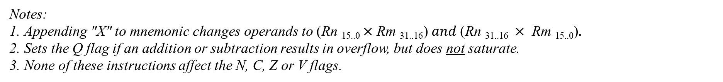
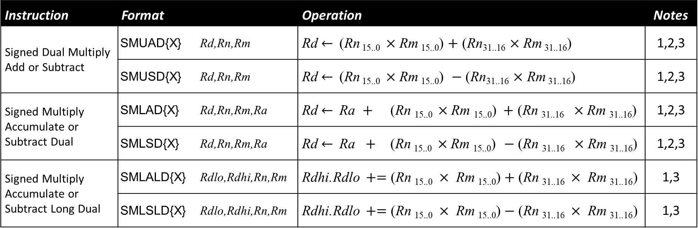
SIMD Multiplication
Instruction | Format |  | Operation | Notes
Signed Dual Multiply Add or Subtract | SMUAD{X} | Rd,Rn,Rm | Rd $←$(Rn _{15..0} $×$ Rm _{15..0}) $+$ (Rn_{31..16} $×$ Rm _{31..16}) | 1,2,3
 | SMUSD{X} | Rd,Rn,Rm | Rd $←$(Rn _{15..0} $×$ Rm _{15..0}) $−$ (Rn_{31..16} $×$ Rm _{31..16}) | 1,2,3
Signed Multiply Accumulate or Subtract Dual | SMLAD{X} | Rd,Rn,Rm,Ra | Rd $←$Ra $+$ (Rn _{15..0} $×$ Rm _{15..0}) $+$ (Rn _{31..16} $×$ Rm _{31..16}) | 1,2,3
 | SMLSD{X} | Rd,Rn,Rm,Ra | Rd $←$Ra $+$ (Rn _{15..0} $×$ Rm _{15..0}) $−$ (Rn _{31..16} $×$ Rm _{31..16}) | 1,2,3
Signed Multiply Accumulate or Subtract Long Dual | SMLALD{X} | Rdlo,Rdhi,Rn,Rm | Rdhi.Rdlo $+=\text{(}\text{Rn} \text{15..0 }× \text{Rm} \text{15..0}\text{)}+\text{(}\text{Rn} \text{31..16 }× \text{Rm} \text{31..16}\text{)}$ | 1,3
 | SMLSLD{X} | Rdlo,Rdhi,Rn,Rm | Rdhi.Rdlo $+=\text{(}\text{Rn} \text{15..0 }× \text{Rm} \text{15..0}\text{)}−\text{(}\text{Rn} \text{31..16 }× \text{Rm} \text{31..16}\text{)}$ | 1,3
Notes:
Appending "X" to mnemonic changes operands to ($\text{Rn} \text{15..0 }$×$\text{Rm} \text{31..16}\text{)} and \text{(}\text{Rn} \text{31..16 }× \text{Rm} \text{15..0}\text{)}.$
Sets the Q flag if an addition or subtraction results in overflow, but does not saturate.
None of these instructions affect the N, C, Z or V flags.

Slide 13
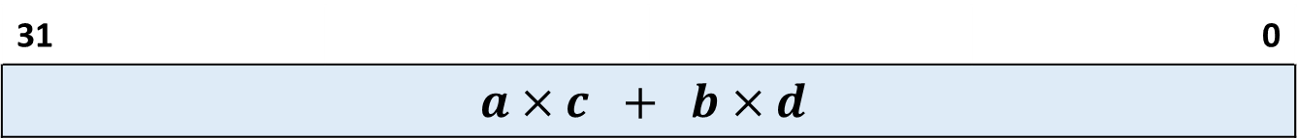
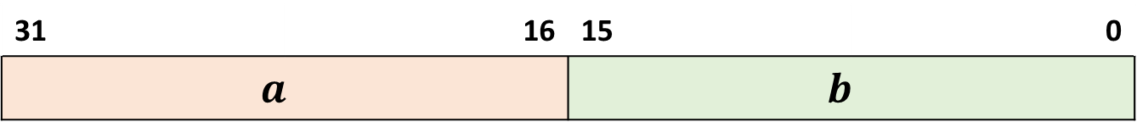
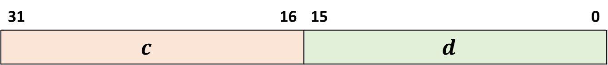


SMUAD R0,R1,R2
31 | 16 | 15 | 0
$$a$$ |  | $$b$$
R1
31 | 16 | 15 | 0
$$c$$ |  | $$d$$
R2
$$a×c$$
+
$$b×d$$
31 |  |  | 0
$$a×c + b×d$$
R0

Slide 14
















SIMD Integer Dot Product
SMLAD
$a$[0] | $a$[1]
$a$[2] | $a$[3]
$$⋯$$ | $⋯$
$a$[n-2] | $a$[n-1]
$b$[0] | $b$[1]
$b$[2] | $b$[3]
$$⋯$$ | $⋯$
$b$[n-2] | $b$[n-1]
× | $\text{×}$
× | ×
× | ×
× | ×
$$+$$
$$+$$
$$+$$
$$+$$
// int32_t SIMD_DotProduct
// (int16_t a[], int16_t b[], uint32_t n);
.global SIMD_DotProduct
SIMD_DotProduct:
PUSH {R4} // Preserve registers R4
LDR R3,=0 // Initialize the result
loop: CBZ R2,done // Test for completion (n = 0)
LDR R4,[R0],4 // Get two 16-bit values from a
LDR R12,[R1],4 // Get two 16-bit values from b
SMLAD R3,R4,R12,R3 // Add 32-bit product to total
SUB R2,R2,2 // Decrement n by 2
B loop // Repeat until done
done: MOV R0,R3 // Copy result to R0 for return
POP {R4} // Restore registers R4
BX LR // Return
$$0$$
$$+$$
$$+$$
$$+$$
$$⋯$$
$$+$$
$a∙$ $b$
The Dot Product is used extensively in computer graphics, such as finding the angle between two vectors or the projection of one vector onto another.

Slide 15












SIMD Finite Impulse Filter
SMUAD
SMLAD
$$0$$
$$0$$
$$0$$
$$g[0]$$
$$g[1]$$
$$g[2]$$
$$g[3]$$
$$g[4]$$
$$g[5]$$
$$⋯$$
$$f[3]$$
$$f[2]$$
$$f[1]$$
$$f[0]$$
$$×$$
$$×$$
$$×$$
$$×$$
// void SIMD_FIR(Q15 g[], Q15 y[], uint32_t length, Q15 f[4]]) ;
.global SIMD_FIR
SIMD_FIR: // Require: |sum of f[i]| < 1.0
PUSH {R4-R6} // Preserve registers
LDRD R5,R4,[R3] // Get the four f coefficients
ROR R5,R5,16 // R5<31..16>=f[0]; R5<15..0>=f[1]
ROR R4,R4,16 // R4<31..16>=f[2]; R4<15..0>=f[3]
MOV R6,0 // Begin w/three 0’s prepended to g:
LDRH R12,[R0] // g[-3] thru g[-1] = 0, and
LSL R12,R12,16 // g[0] loaded from input.
loop: CBZ R2,done // Test for completion (length = 0)
SMUAD R3,R4,R6 // R3 = f[0]*g[i] + f[1]*g[i-1]
SMLAD R3,R5,R12,R3 // + f[2]*g[i-2] + f[3]*g[i-3]
LSR R3,R3,15 // Select Q1.15 format bits
STRH R3,[R1],2 // Store filtered result (y[i])
LSR R6,R6,16 // Shift the input samples by 1:
ORR R6,R6,R12,LSL 16 // R6 = 2nd and 3rd input sample
LSR R7,R12,16 // R12 = 4th input sample
LDRH R3,[R0],2 // R3 = 5th input sample, i++
ORR R7,R12,R3,LSL 16 // R12 = 4th and 5th input sample
SUB R2,R2,1 // Decrement length
B loop // Repeat
done: POP {R4-R6} // Restore registers
BX LR // Return
$$+$$
$$+$$
$$+$$
$$y[0]$$
$$y[1]$$
$$y[2]$$
$$y[3]$$
$$⋯$$
$$⋯$$
$$⋯$$
Finite Impulse Filters are used in signal processing to implement almost any sort of frequency response, such as removing high frequency noise.

Slide 16

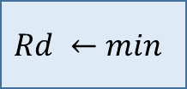
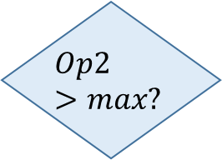
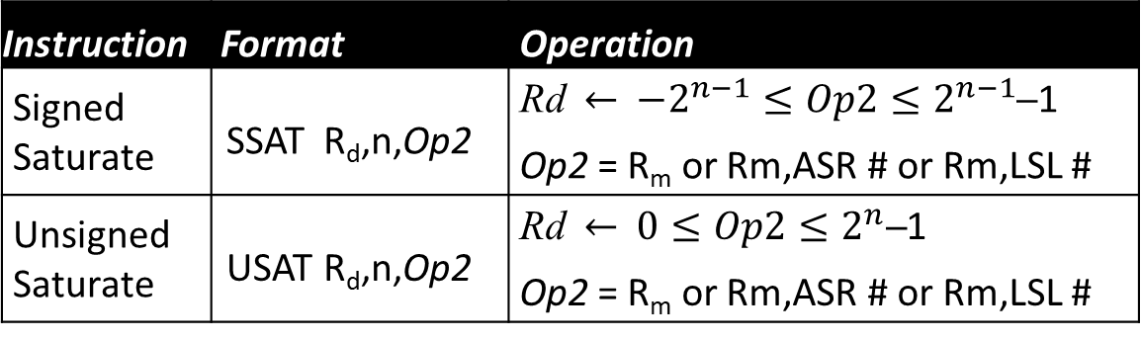
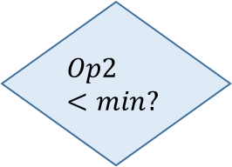
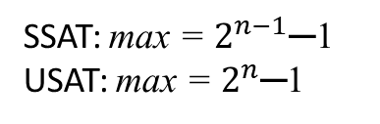
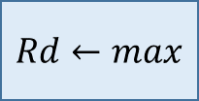
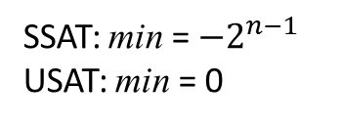
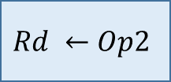

SATURATION (LIMITING) INSTRUCTIONS
SSAT: min = $−2^{n−1}$
USAT: min = 0
Instruction | Format |  | Operation
Signed Saturate | SSAT | R_{d},n,Op2 | Rd $←$ $−2^{n−1}≤Op2≤2^{n−1}$─1 Op2 = R_{m} or Rm,ASR # or Rm,LSL #
Unsigned Saturate | USAT | R_{d},n,Op2 | Rd $←$ $0≤Op2≤2^{n}\text{─}$1 Op2 = R_{m} or Rm,ASR # or Rm,LSL #
$$Op2<min?$$
Yes
SSAT: max = $2^{n−1}\text{─}\text{1}$
USAT: max = $2^{n}\text{─}$1
$$Op2>max?$$
The Q flag is set when saturation occurs; no other flags are affected.
Yes
Given a value, these instructions limit it to the range of an N-bit representation.
$$Q←1$$
$$Q←1$$
$$Rd ←min$$
$$Rd ←Op2$$
$$Rd←max$$
LDRB R0,rgb_red // This code doubles the intensity of the
USAT R0,8,R0,LSL 1 // 8-bit red RGB component of a pixel, and
STRB R0,rgb_red // limits the result to avoid overflow.

Slide 17

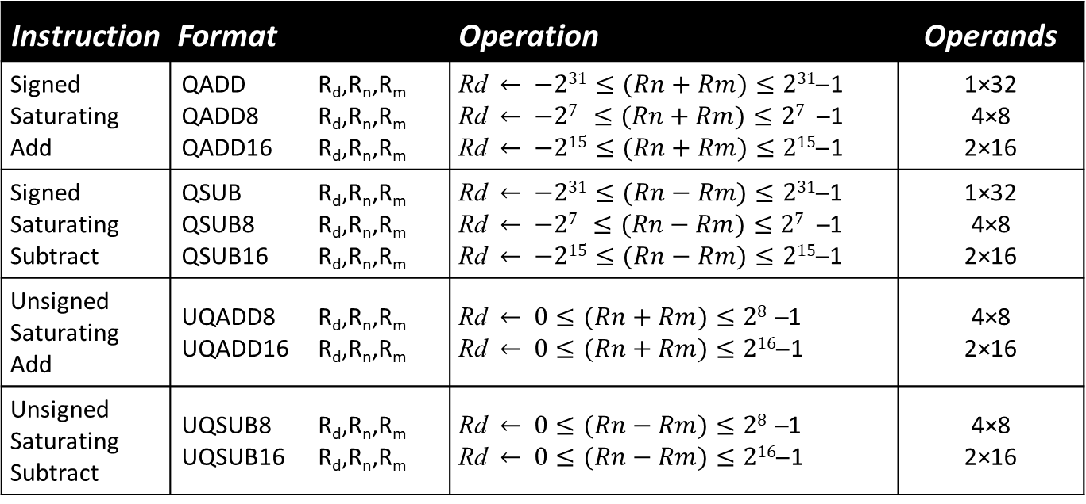
SATURATING ARITHMETIC
Instruction | Format |  | Operation | Operands
Signed Saturating Add | QADD QADD8 QADD16 | R_{d},R_{n},R_{m} R_{d},R_{n},R_{m} R_{d},R_{n},R_{m} | Rd $←$ $−231≤(Rn+Rm)≤231\text{─}$1 Rd $←$ $−27 ≤(Rn+Rm)≤27 \text{─}$1 Rd $←$ $−215≤(Rn+Rm)≤215\text{─}$1 | 1×32 4×8 2×16
Signed Saturating Subtract | QSUB QSUB8 QSUB16 | R_{d},R_{n},R_{m} R_{d},R_{n},R_{m} R_{d},R_{n},R_{m} | Rd $←$ $−231≤(Rn−Rm)≤231\text{─}$1 Rd $←$ $−27 ≤(Rn−Rm)≤27 \text{─}$1 Rd $←$ $−215≤(Rn−Rm)≤215\text{─}$1 | 1×32 4×8 2×16
Unsigned Saturating Add | UQADD8 UQADD16 | R_{d},R_{n},R_{m} R_{d},R_{n},R_{m} | Rd $←$ $0≤(Rn+Rm)≤2\text{8 }\text{─}$1 Rd $←$ $0≤(Rn+Rm)≤2\text{16}\text{─}$1 | 4×8 2×16
Unsigned Saturating Subtract | UQSUB8 UQSUB16 | R_{d},R_{n},R_{m} R_{d},R_{n},R_{m} | Rd $←$ $0≤(Rn−Rm)≤2\text{8 }\text{─}$1 Rd $←$ $0≤(Rn−Rm)≤2\text{16}\text{─}$1 | 4×8 2×16
Each instruction works on a single 32-bit value, two 16-bit values, or four 8-bit values all at once. The Q flag is set when saturation occurs; no other flags are affected.
For example, these instructions are used to process video (three 8-bit RGB values/pixel)

Slide 18
UQADD8 R0,R1,R2
31 | 24 | 23 | 16 | 15 | 8 | 7 | 0
100 |  | 135 |  | 221 |  | 97
R1
UQADD8 is used to simultaneously increase the brightness of four RGB components of a digital image without overflow.
31 | 24 | 23 | 16 | 15 | 8 | 7 | 0
100 |  | 100 |  | 100 |  | 100
R2
+
+
+
+
200
235
321
197
<= 255
<= 255
<= 255
<= 255
31 | 24 | 23 | 16 | 15 | 8 | 7 | 0
200 |  | 235 |  | 255 |  | 197
R0

Slide 19
The Q Flag (bit 27 in the APSR)
The Q flag is a “Dual-Purpose” flag:
Set when SIMD multiply instructions overflow the product
Set when saturating instructions limit their result
The Q flag is a “Sticky” flag:
SIMD & saturating instructions can set Q to 1, but not clear it.
Only way to clear Q is to use MRS and MSR instructions.
There is no condition code or conditional branch that tests the Q flag!

Slide 20
Copying flags to/from Registers
Instruction | Format |  | Operation
Move (copy) the contents of a general-purpose register into the APSR flags. | MSR | APSR_nzcvq,R_{n} | NZCVQ ← R_{n} (bits 31-27) (Bits 26-0 of PSR are unaffected)
Move (copy) the contents of the APSR into a general-purpose register. | MRS | R_{d},APSR | NZCVQ → R_{d} (bits 31-27) (Bits 26-0 of R_{d} are filled with 0’s)
// Testing the Q flag:
MRS R0,APSR // Copy flags to R0
TST R0,1<<27 // Check value of Q
BNE QFlagSet // Branch if Q=1
// Clearing the Q flag:
MRS R0,APSR // Copy flags to R0
BIC R0,R0,1<<27 // Clear Q flag to 0
MSR APSR_nzcvq,R0 // Copy R0 to flags

